Slide 1
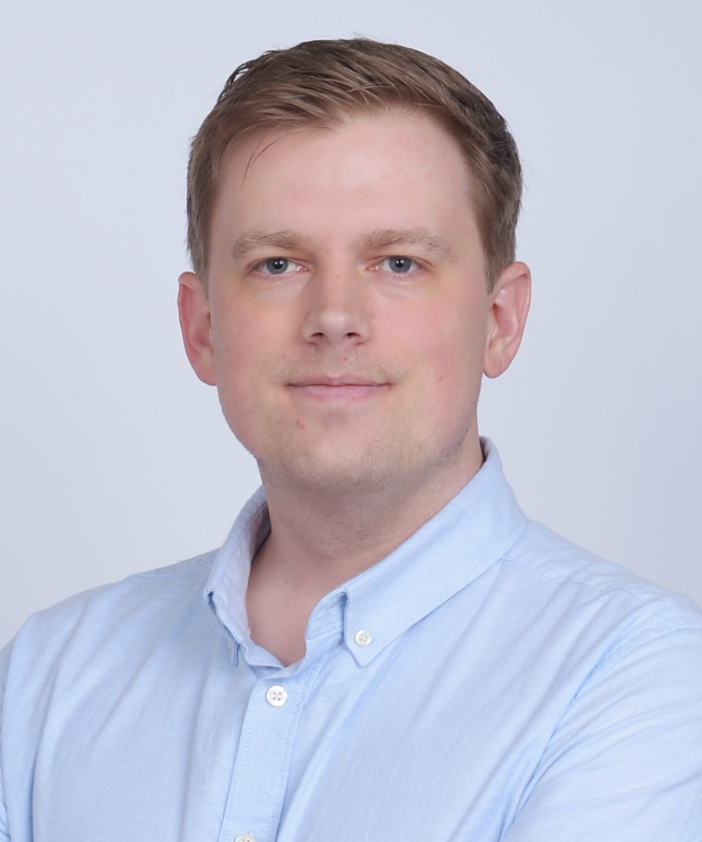
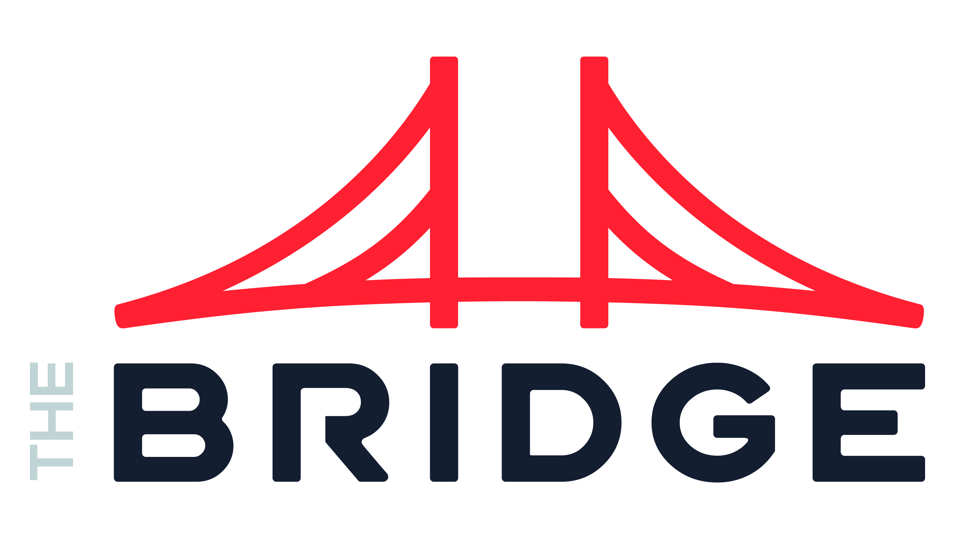
Jacob Erickson Data & AI
INDUSTRIES
Industry Experience
Engineering | Hospitality & Entertainment | High-Tech & Software | Education | Real Estate | Restaurant
EXPERIENCE
Digital Solutions for Support Departments | Engineering
Problem: Multiple departments – including Human Resources, Finance & Accounting, and Health & Safety – faced inefficiencies due to analog or manual processes and required applications and automation to improve efficacy.
Value: Online applications and automated flows were developed and launched to significantly reduce time sunk in handling previously manual tasks, while also increasing data accuracy throughout the lifecycle of the business processes.
Tools: Power Apps, Power Automate, SharePoint Online, Dataverse, Power BI
Role: Worked as the lead architect and technical liaison on myriad projects, met with stakeholders to gather requirements, offered guidance and proposals, designed and developed solutions in tandem with his team, and led the quality assurance testing process and production launch of each of new solution.
Improving Contract Renegotiation Process| Engineering
Problem: The contract renegotiation process for Client was lacking a single source of truth and was entirely manual, involving tracking down old and out-of-date information across numerous sources, none of which was easily accessible by multiple team members at a time.
Value: A new data source was built to house information captured and presented by a new application, with the app providing a single source of up-to-date data for all contracts. Automation was also provided to remind negotiators when contracts were closing in on negotiation windows to better focus the attention of the overqualified workforce.
Tools: Power Apps, Dataverse, Power Automate, SQL
Role: Worked as the sole developer of the project, communicating directly with project owners to gather requirements and ensure full functionality in a timely manner.
BACKGROUND
Functional Skills
Application Development | Automation Design and Integration | Solution Architecture | Data Architecture | Data Analysis and Visualization | Project Management
Qualifications:
Digital development leader with a heavy focus on partnership and translating business requirements into technical plans, turning goals into fully-realized solutions. Jacob brings experience working together with stakeholders to bring their ideas to life and enjoys heading up teams – comprised of either internal developers, client-based staff, or a mix of both – to ensure quality deliverables on or ahead of schedule.
BIO & CONTACT INFO
Email
Jacob.Erickson@thebridge.com
Mobile
(720) 388-3770
Location
Loveland, Colorado
Jacob has been working in software development for 5 years, focused initially in full-stack development before growing into an expert in Microsoft’s Power Platform. He loves coaching teams, spearheading new projects, and helping clients find ways to improve their processes. In his free time, he enjoys exploring Northern Colorado, serving his community, and unabashedly rooting for the San Francisco Giants when they visit Coors Field.

